Slide 1
IBM x Columbia
Weekly Meeting
IBM x Columbia Core Team
10/23/2025

Slide 2
AGENDA
1
2
3
4
5
IBM x Columbia
10 / 2025
Why we're here today
Overview
Timeline
Team Check-in
Outcome Classification
Next Step

Slide 3
Overview
This weekly meeting will be focusing on establishing a clear roadmap and reviewing initial progress for the IBM x Columbia project. Including the timeline, team check-in, and some Q&A at the end.

Slide 4
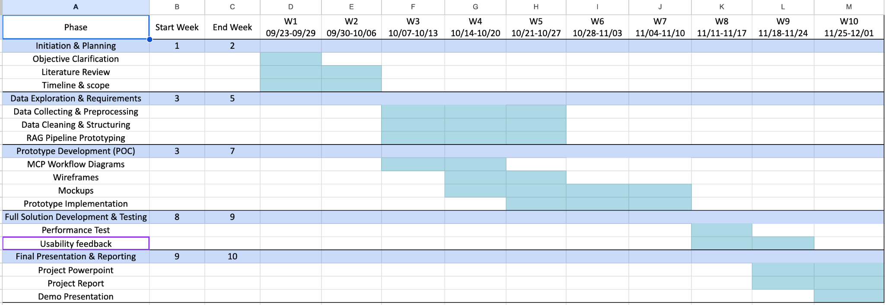
Timeline

Slide 5
Team Check-in
Data & Knowledge Engineering Team
Generative AI & Model Development Team
User Experience & Application Development Team
Evaluation & Compliance Team

Slide 6
Data & Knowledge Engineering Team
Learning RAG Framework: Continued exploring the concepts and workflows of Retrieval-Augmented Generation (RAG) to better understand how embedding and retrieval pipelines enhance data accessibility.
Technical Exploration: We successfully explored how to flatten JSON structures into indexable chunks and convert the Training Plan document into an embedded database, enabling efficient vector-based search and retrieval.
Current Focus: After communicate with GenAI Team, our immediate goal is to complete data cleaning for all EPLC phases. We aim to finish all phases documents (Development, Design, Requirement, and Implementation Phases) by next Tuesday.

Slide 7
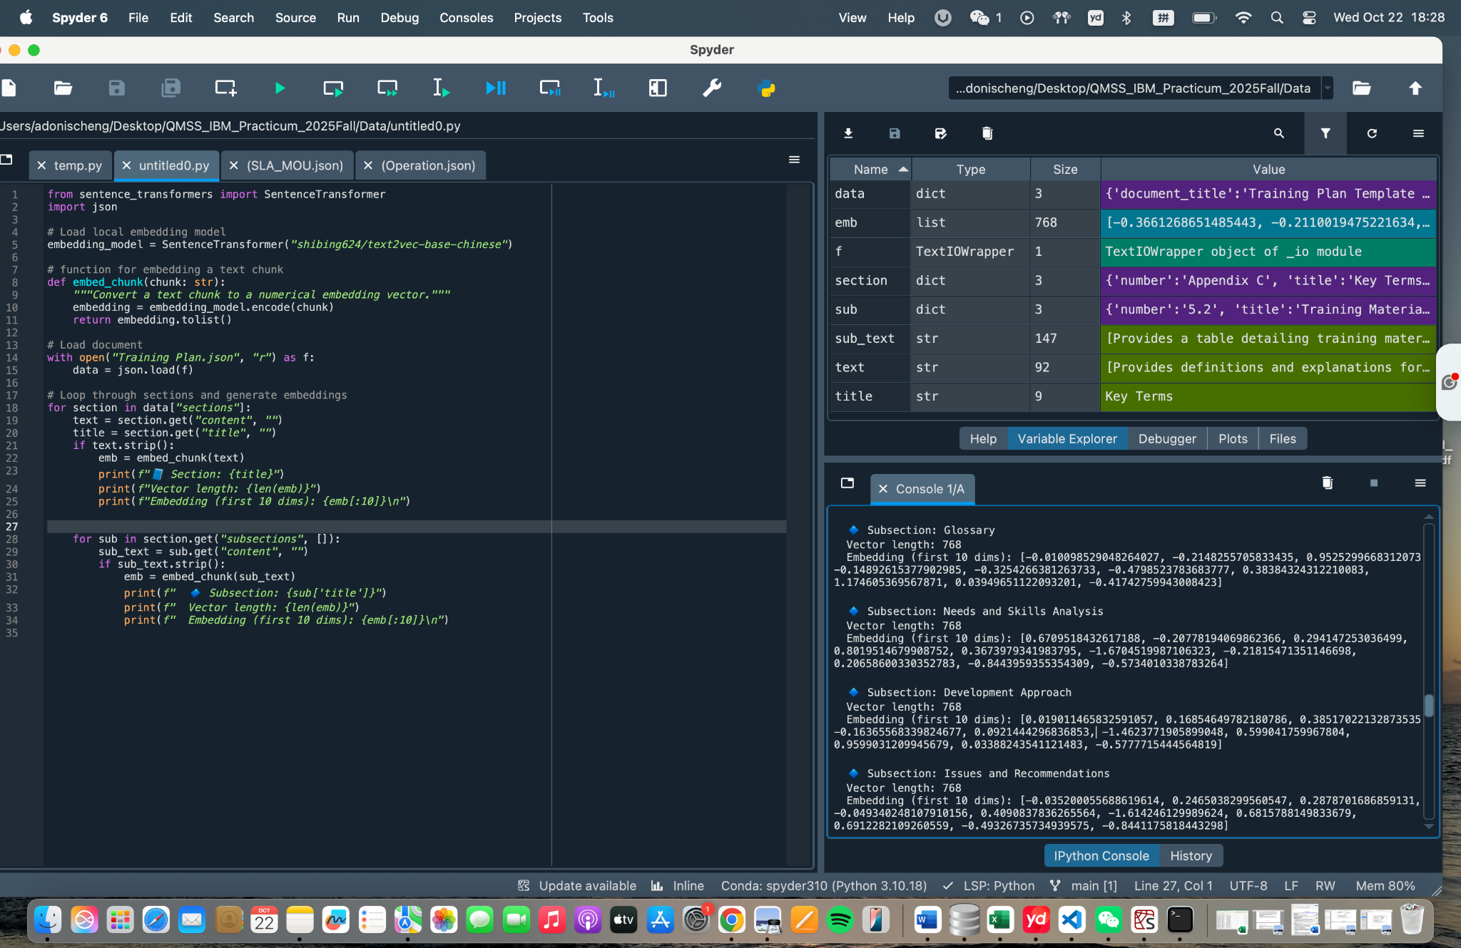
Data & Knowledge Engineering Team

Slide 8
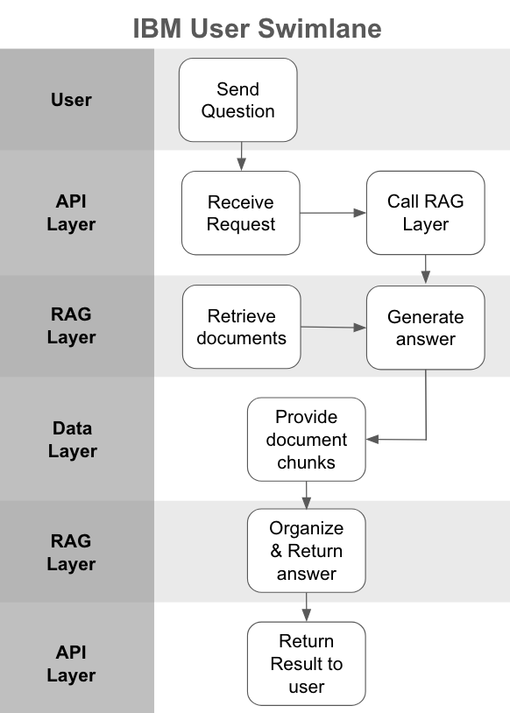
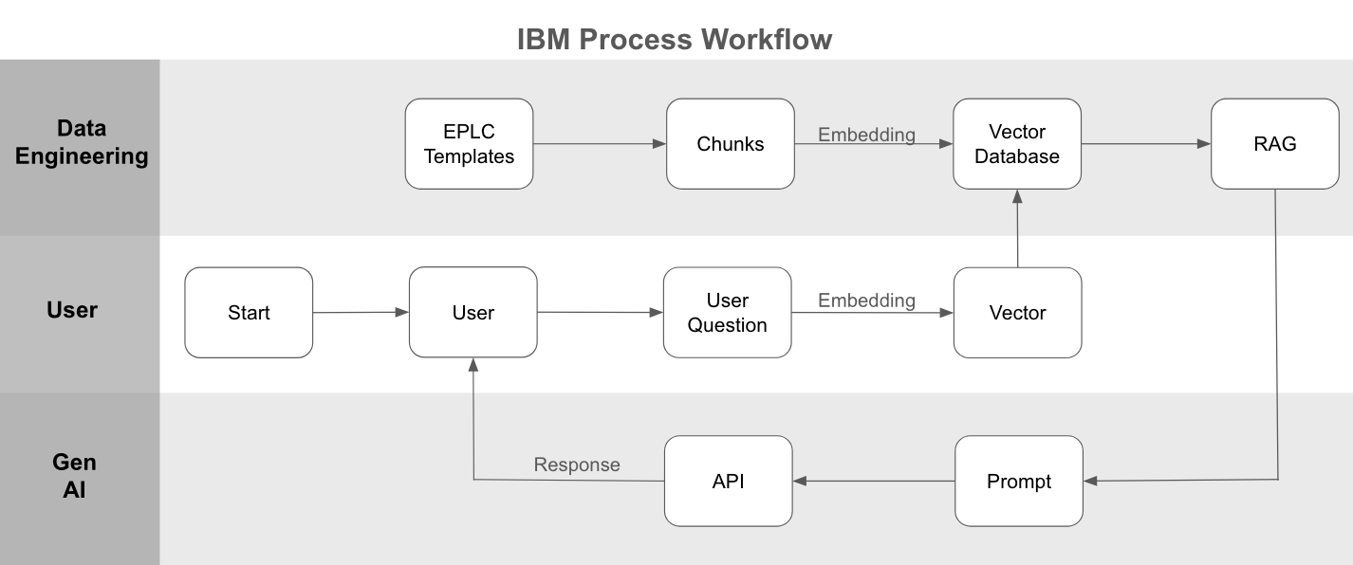
GenAI & Model Development

Slide 9
GenAI & Model Development
Goal: Identify the most suitable OpenAI model for the EPLC chatbot prototype
Models tested: GPT-5-Nano, GPT-4o-Mini, GPT-4o
Data source：Cleaned EPLC JSON files (Development)
Code files：test_api.py 、benchmark.py
Evaluation metrics：response latency、token usage、answer quality

Slide 10
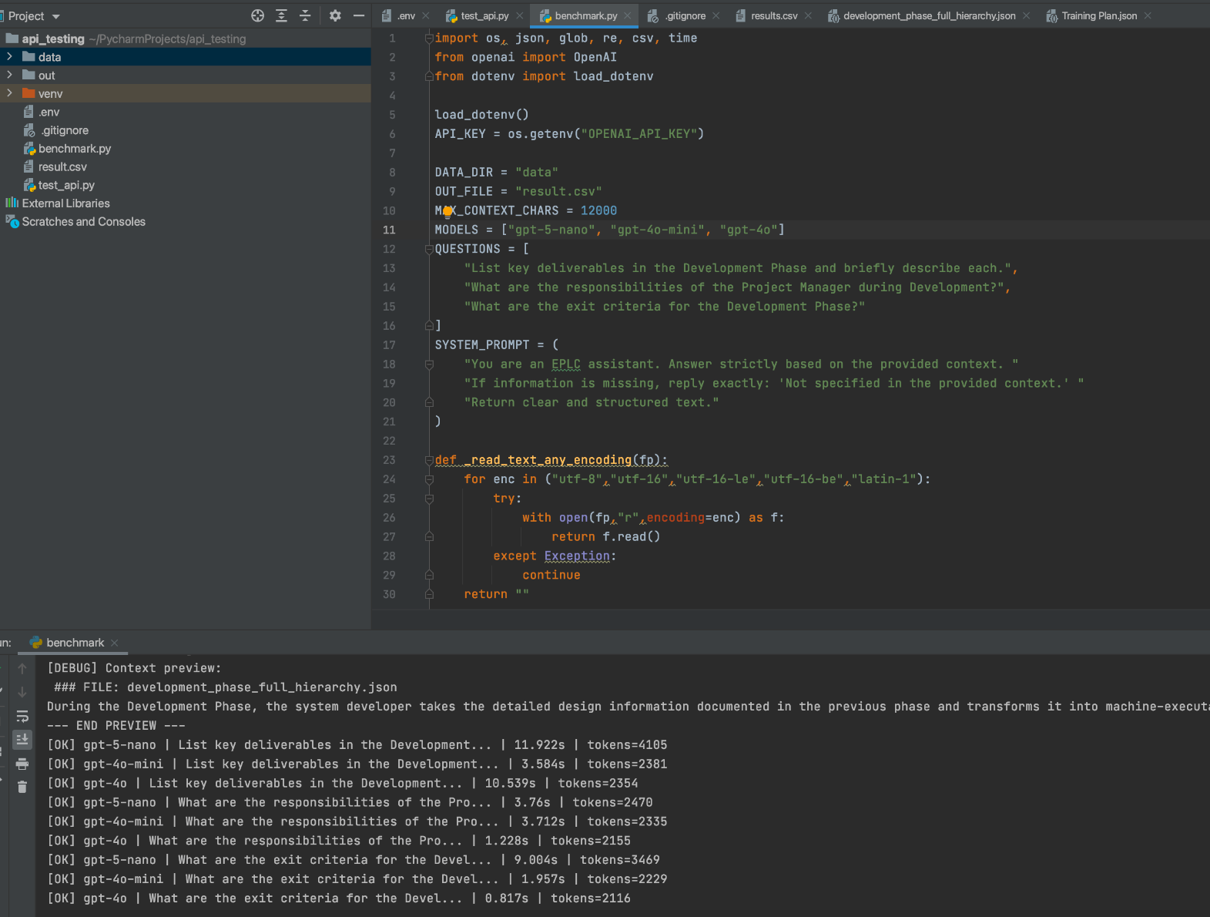
GenAI & Model Development

Slide 11
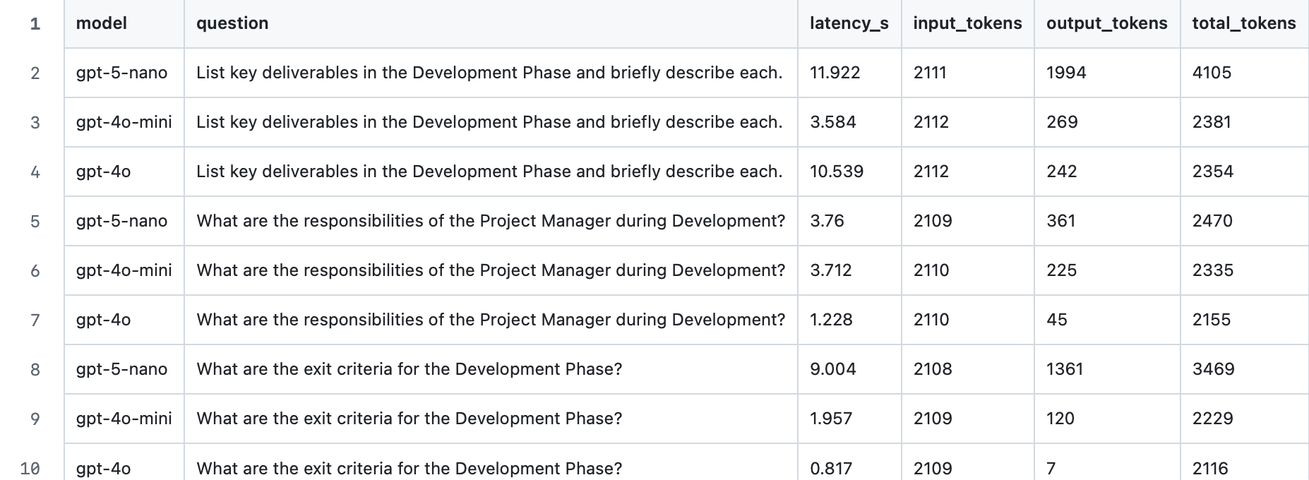
GenAI & Model Development

Slide 12
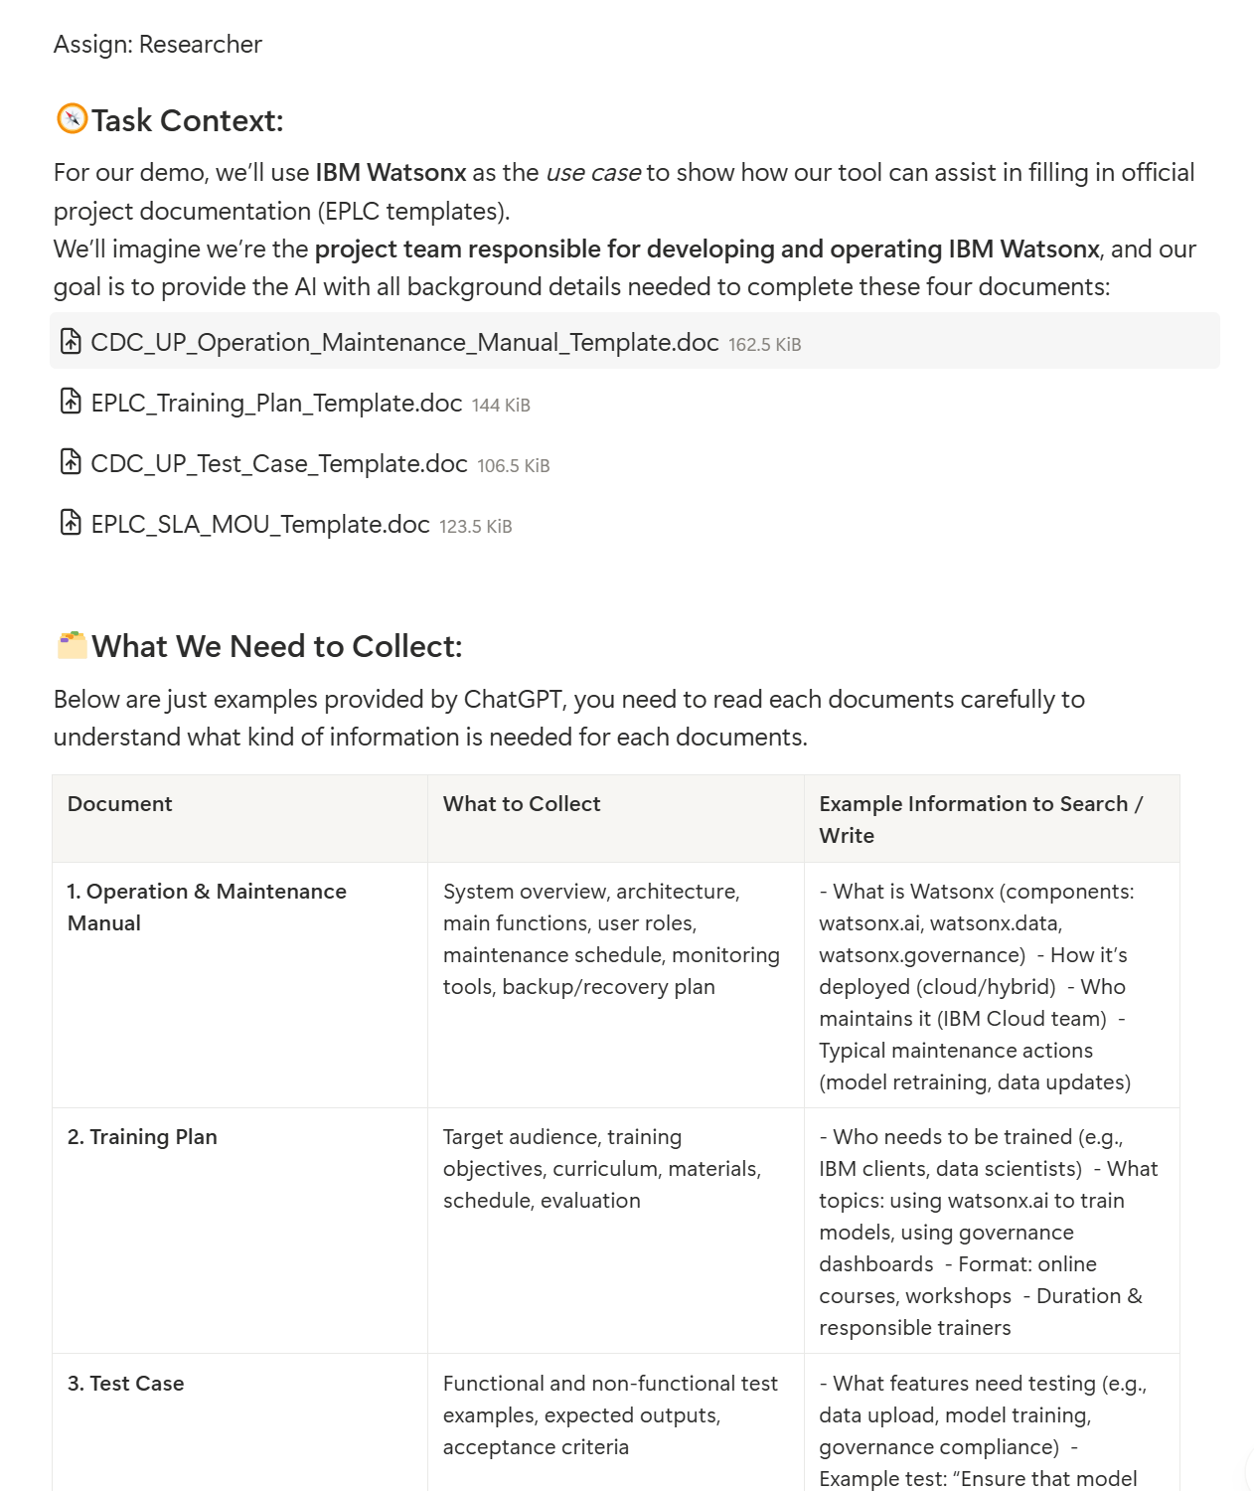
User Experience & Application Development Team
In progress:
The Use Case documents collection
Finished：
Conversation Script
UX Flow
Low-fidelity Wireframe
Next Week:
High-fidelity Wireframe
Clickable prototype

Slide 13
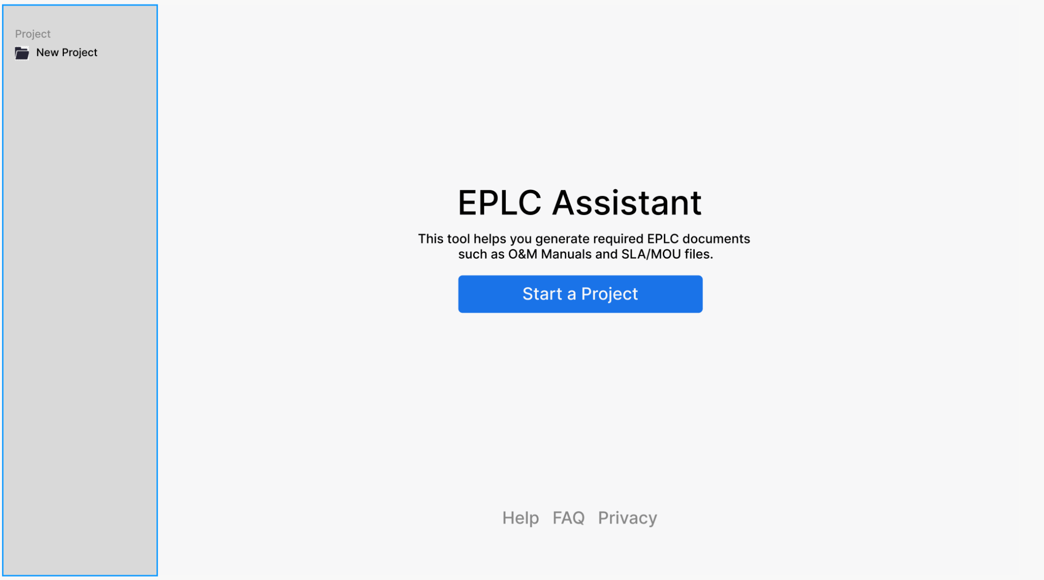
User Experience & Application Development Team

Slide 14
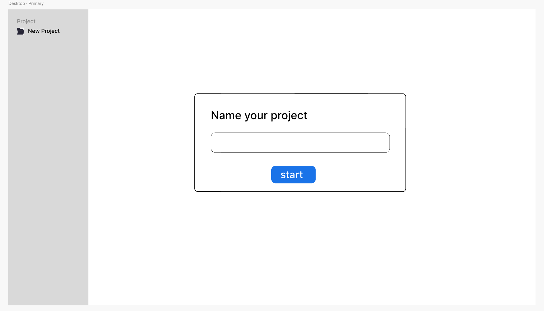
User Experience & Application Development Team

Slide 15
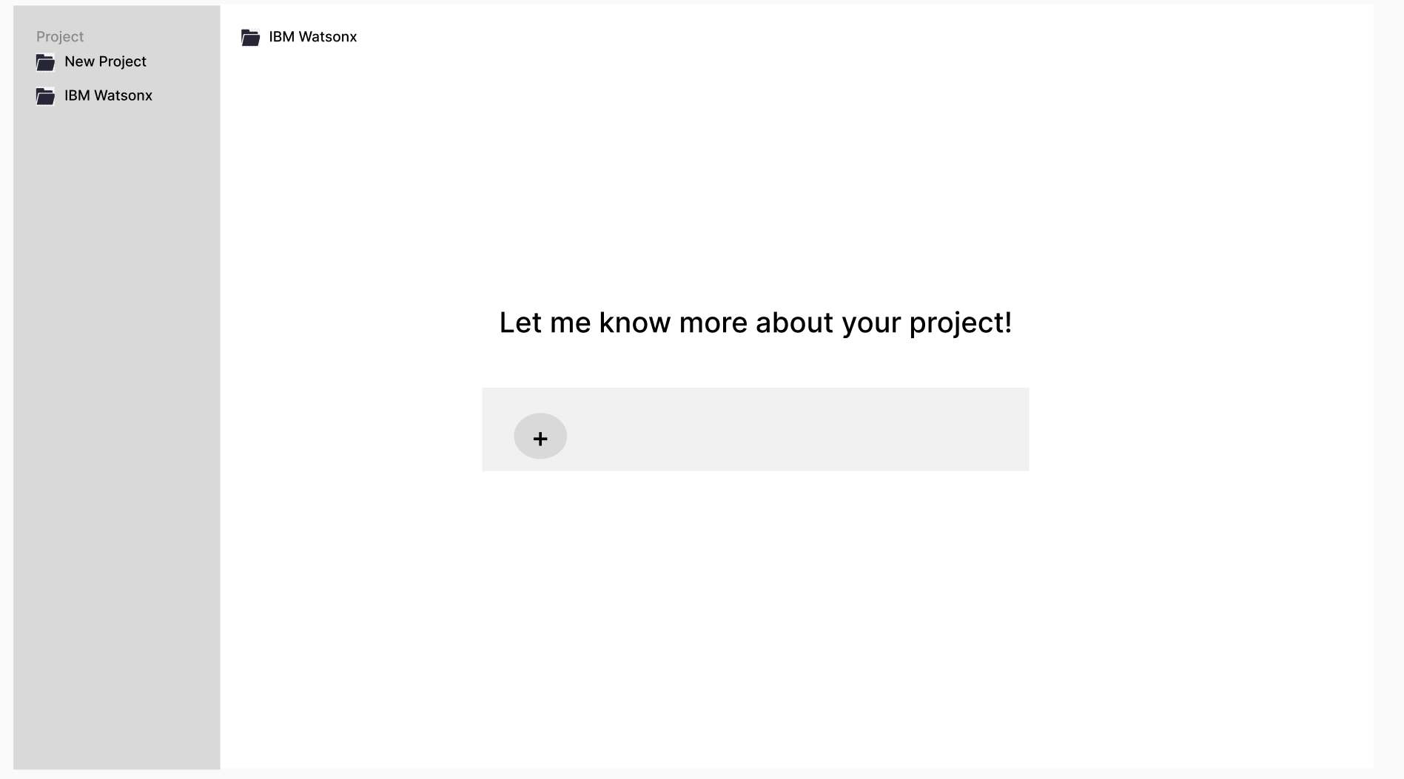
User Experience & Application Development Team

Slide 16
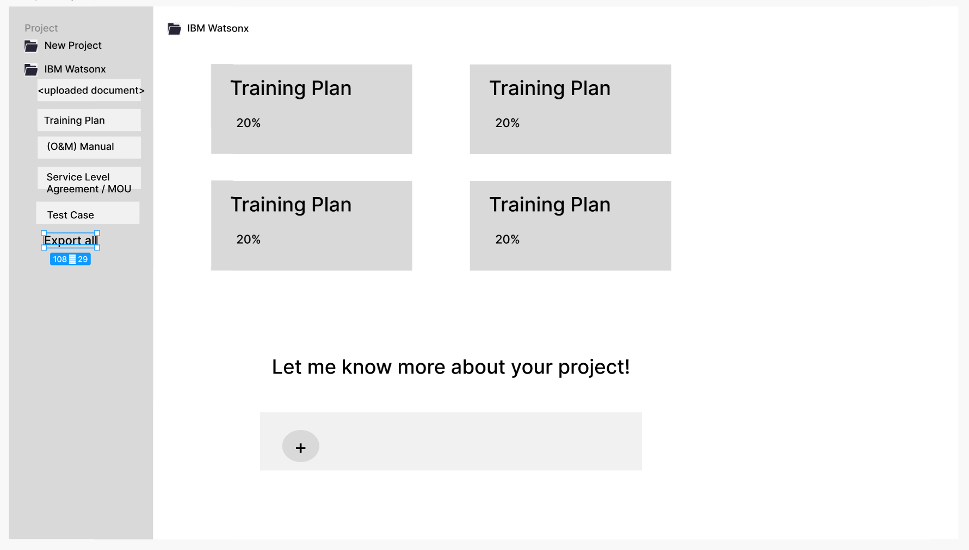
User Experience & Application Development Team

Slide 17
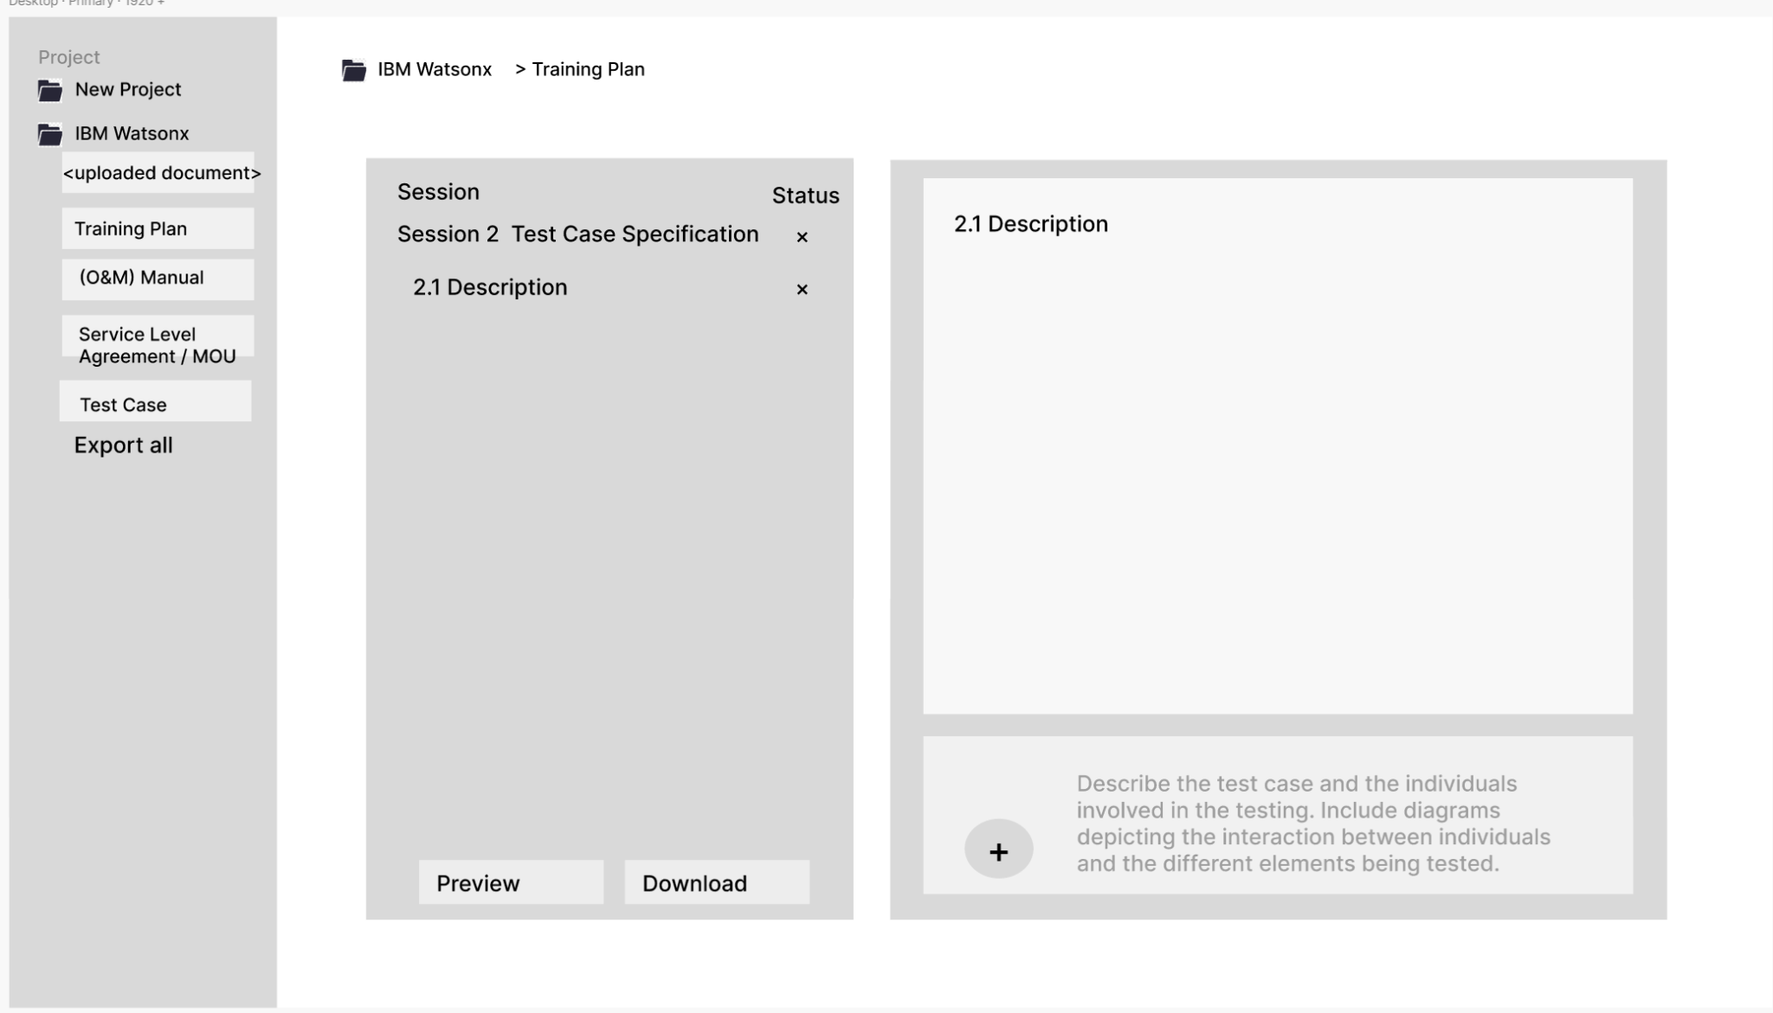
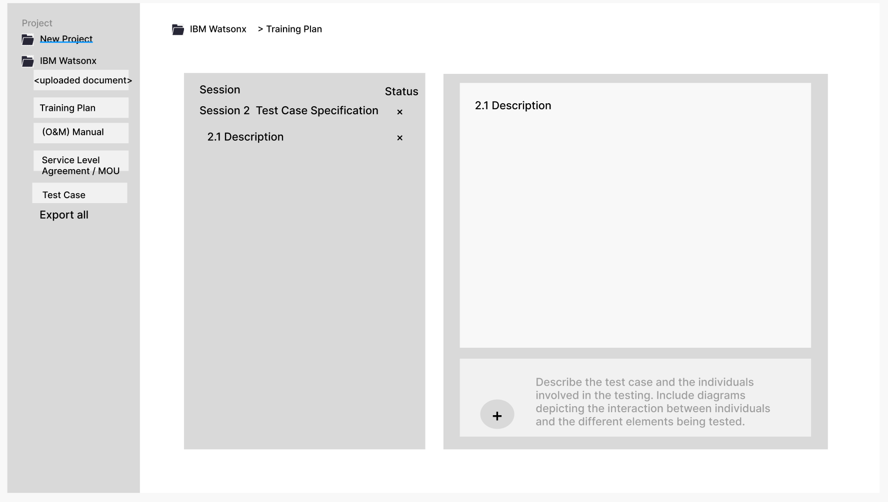
User Experience & Application Development Team

Slide 18
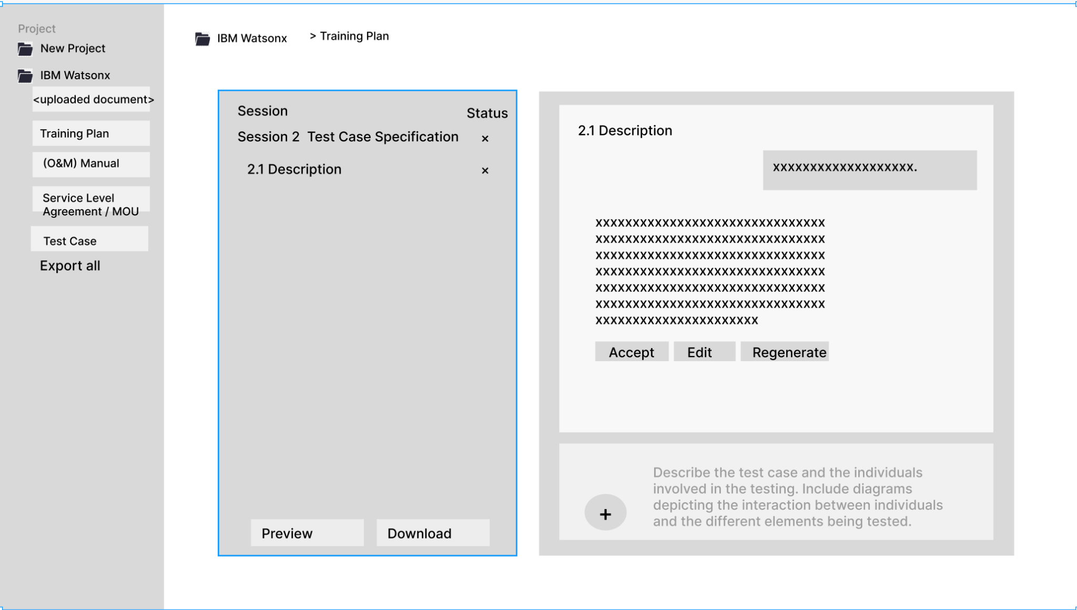
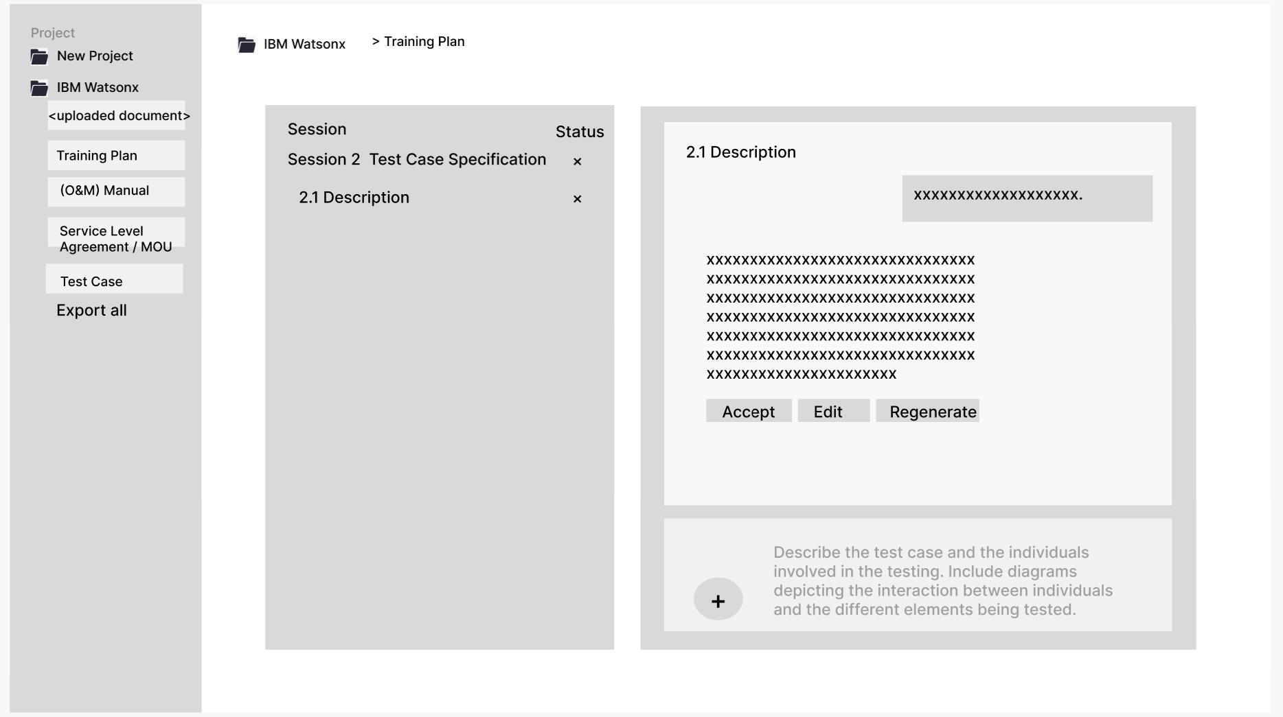
User Experience & Application Development Team

Slide 19
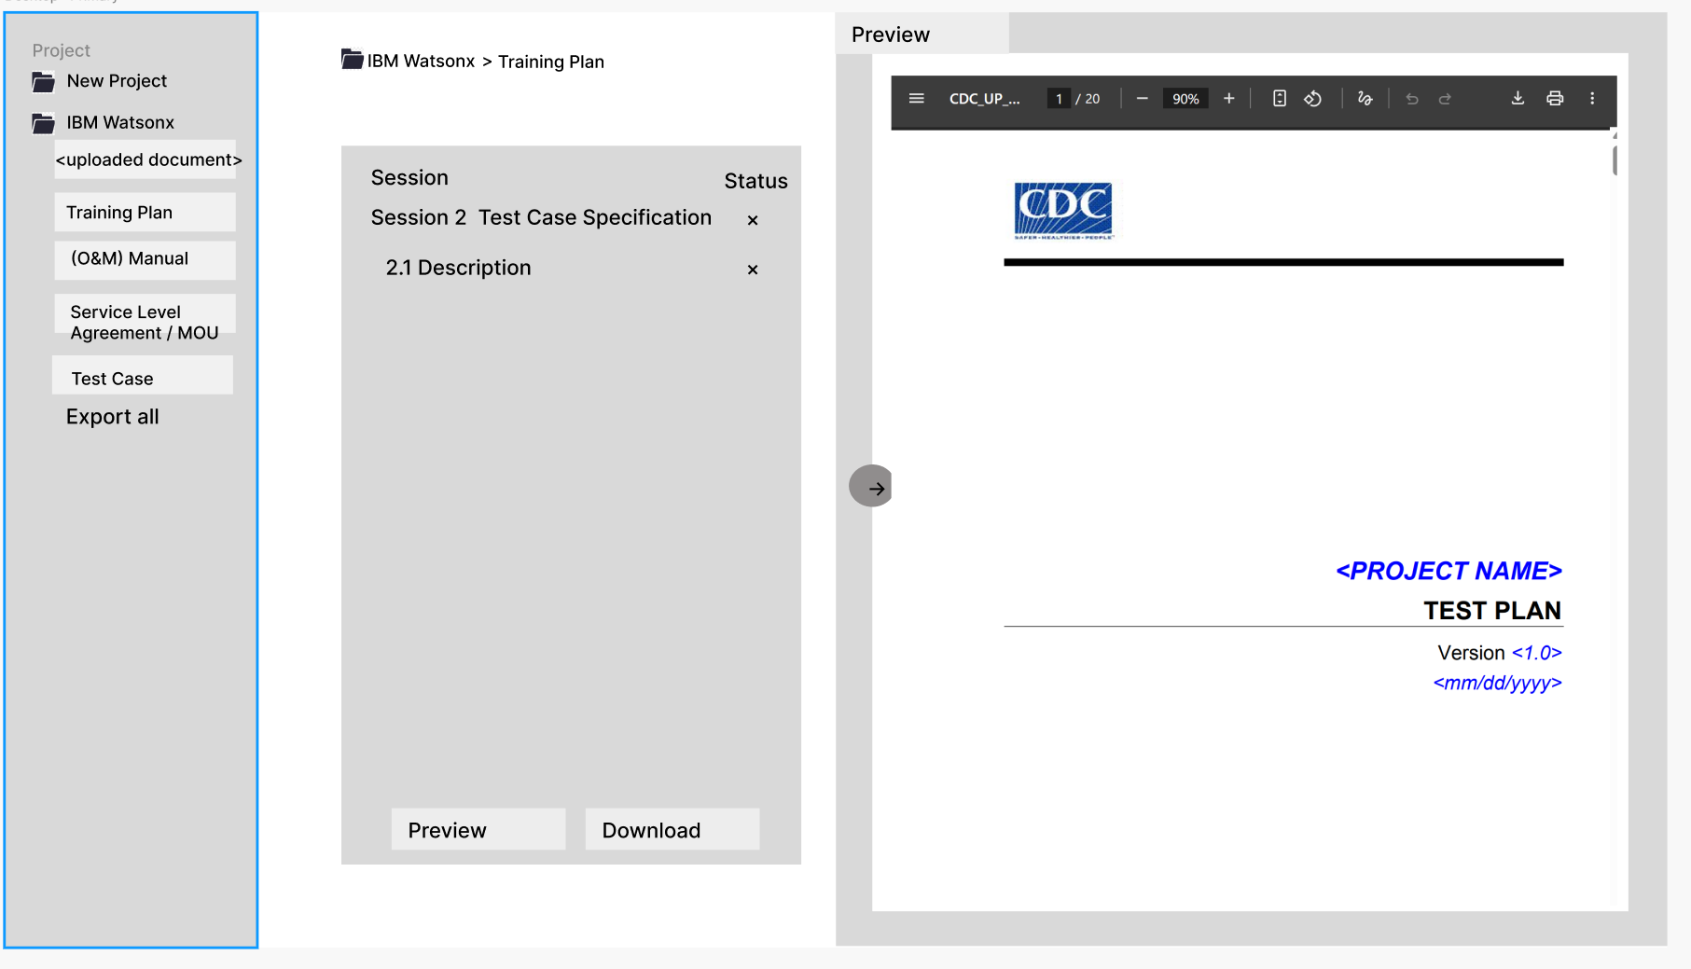
User Experience & Application Development Team

Slide 20
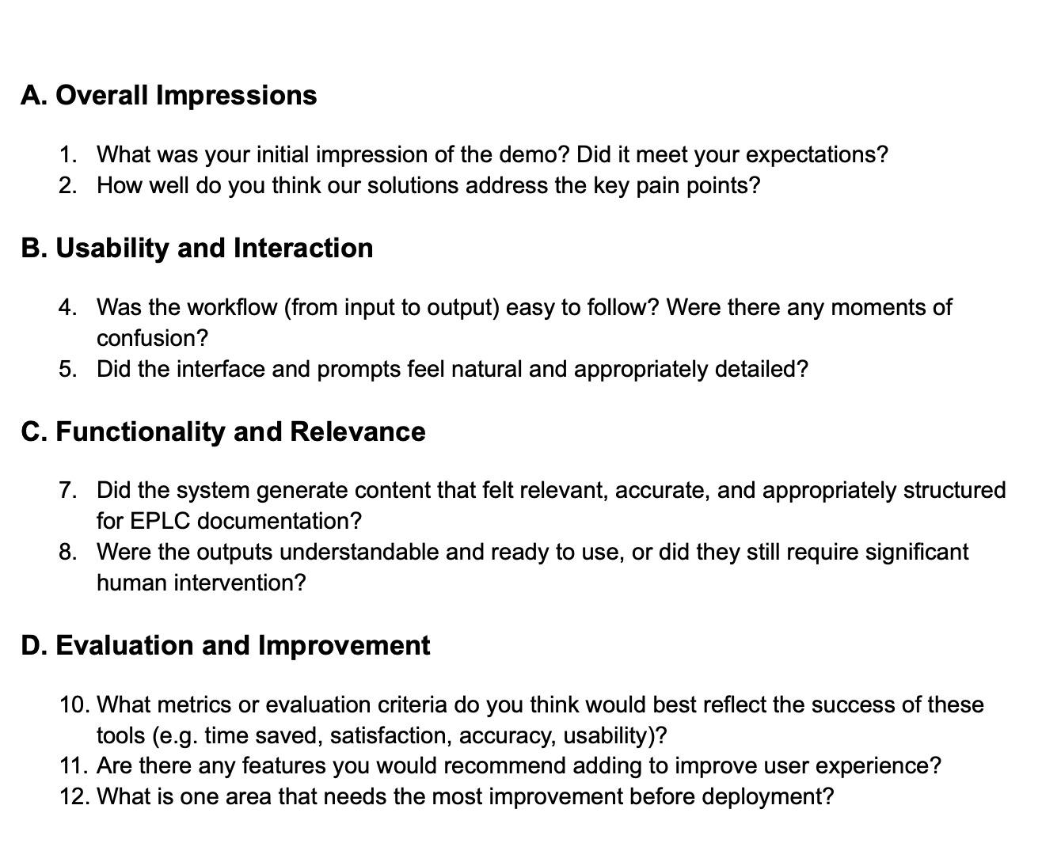
Evaluation & Compliance Team
Demo Testing Meeting: gather qualitative feedback for further refinement.
Usability & workflow clarity
Output relevance and accuracy
Evaluation Survey (End of Project): to collect quantitative and qualitative feedback from a larger group of IBM mentors and whole team members.
Pop up rating

Slide 21
Questions

Slide 22

NEXT
STEPS
Keep up with the timeline, communicate with the sub-team for better support. Diving into the topics we’ve touched on today to deepen our understanding on the project, and starting the data preparation procedure.

Slide 23
THANK
YOU!
IBM x Columbia
10 / 2025
Columbia Practicum Core Team

